Slide 1
Chuck Zelek Ph.D.
Senior Economist
US DOE Office of Fossil Energy
Appalachian Storage Hub Conference
Hilton Garden Inn
Southpointe PA
June 6th, 2019
Appalachian Petrochemicals
A Generational Opportunity for the Ohio Valley

Slide 2
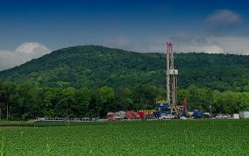

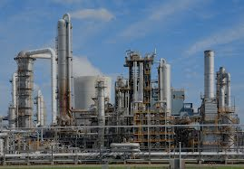
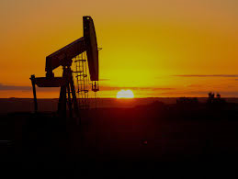

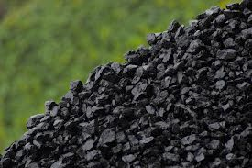



Fossil Energy Critical in All Sectors
Natural Gas
29%
Residential & Commercial
11%
92% Fossil Energy
Industrial
22%
88% Fossil Energy
Oil
37%
80%
Fossil Energy
Transportation
29%
95% Fossil Energy
Coal
14%
Power
38%
60% Fossil Energy
Renewable 11%
Nuclear 9%
EIA, Annual Energy Outlook 2017, Reference Case, https://www.eia.gov/totalenergy/data/monthly/pdf/flow/css_2017_energy.pdf

Slide 3
The US DOE Office of Fossil Energy (FE) Mission and Goals
MISSION
Discover and develop advanced fossil energy technologies to ensure American energy dominance, create American jobs, support a resilient infrastructure, maintain environmental stewardship, and enhance America’s economy. Ensure America’s access to and use of safe, secure, reliable, and affordable fossil energy resources and strategic reserves.
STRATEGIC GOALS
Develop secure, affordable, and reliable fossil energy technologies to realize the full value of domestic energy resources.
Enhance U.S. economic and energy security through prudent policy, advanced technology, and the use of strategic reserves.
Develop and maintain world-class organizational excellence in research and operations to safely, securely, and reliably meet fossil energy challenges for the next generation.
Promote exports of domestically produced hydrocarbons and fossil energy technologies.

Slide 4

The National Energy Technology Laboratory (NETL) is FE’s National Laboratory
Idaho
National Lab
Pacific Northwest
National Lab
Ames Lab
Argonne
National Lab
Mission
Fermilab
Brookhaven
National Lab
Berkeley Lab
Princeton Plasma
Physics Lab
SLAC National
Accelerator
Thomas Jefferson
National Accelerator
Lawrence Livermore
National Lab
Oak Ridge
National Lab
Sandia
National Labs
Savannah River
National Lab
Office of Science
National Nuclear Security Administration
Environmental Management
Fossil Energy
Nuclear Energy
Energy Efficiency & Renewable Energy
Los Alamos
National Lab
National Renewable
Energy Lab

Slide 5
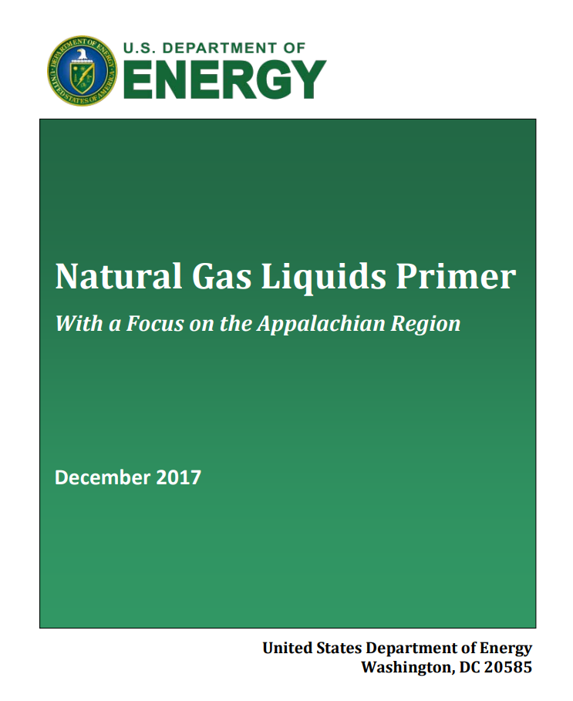
DOE Reports Related to an Appalachian Petrochemical Industry
In December 2017 (updated version released June 2018), the U.S. Department of Energy published “Natural Gas Liquids (NGLs) Primer” that showcases the resource potential of NGLs, specifically in the Appalachian region
In December 2018, the U.S. Department of Energy published the report to Congress, “Ethane Storage and Distribution Hub in the United States. The report highlights the potential for the development of an ethane hub in Appalachia
“There is an incredible opportunity to establish an ethane storage and distribution hub in the Appalachian region and build a robust petrochemical industry in Appalachia,” said U.S. Secretary of Energy Rick Perry today at the annual National Petroleum Council Meeting in Washington D.C. “As our report shows, there is sufficient global need, and enough regional resources, to help the U.S. gain a significant share of the global petrochemical market. The Trump Administration would also support an Appalachia hub to strengthen our energy and manufacturing security by increasing our geographic production diversity.” (December 2018)
NGL Primer: https://www.energy.gov/sites/prod/files/2017/12/f46/NGL%20Primer.pdf
Report to Congress: https://www.energy.gov/sites/prod/files/2018/12/f58/Nov%202018%20DOE%20Ethane%20Hub%20Report.pdf
Source: https://www.nrcce.wvu.edu/news/2017/08/29/wvu-led-research-team-lays-foundation-for-natural-gas-storage-hub-opportunity-for-economic-growth-in-the-region

Slide 6
Petrochemicals Present Generational Opportunity for Ohio Valley
Ethane
• Underutilized co-product of the Appalachian shale gas industry
• Principal petrochemical feedstock for a diversity of consumer products
• Opportunity for Appalachian petrochemical industry
Expanded Appalachian petrochemical industry can support
• Five world-scale petrochemical crackers
• Regional pipelines and storage network
• Downstream manufacturing facilities
Economic Benefits
• 100,000 permanent jobs
• $6B annual payroll
• $30B+ private capital investment
• $28B annual revenue
• $3B annual tax revenue
• Reduced production cost for ethane-based intermediate products, which feed the Midwest manufacturing base
Energy and Manufacturing Security Benefits
• Geographically diversifies U.S. petrochemical manufacturing base
• Expands shale gas production opportunities by providing an outlet for co-produced ethane

Slide 7
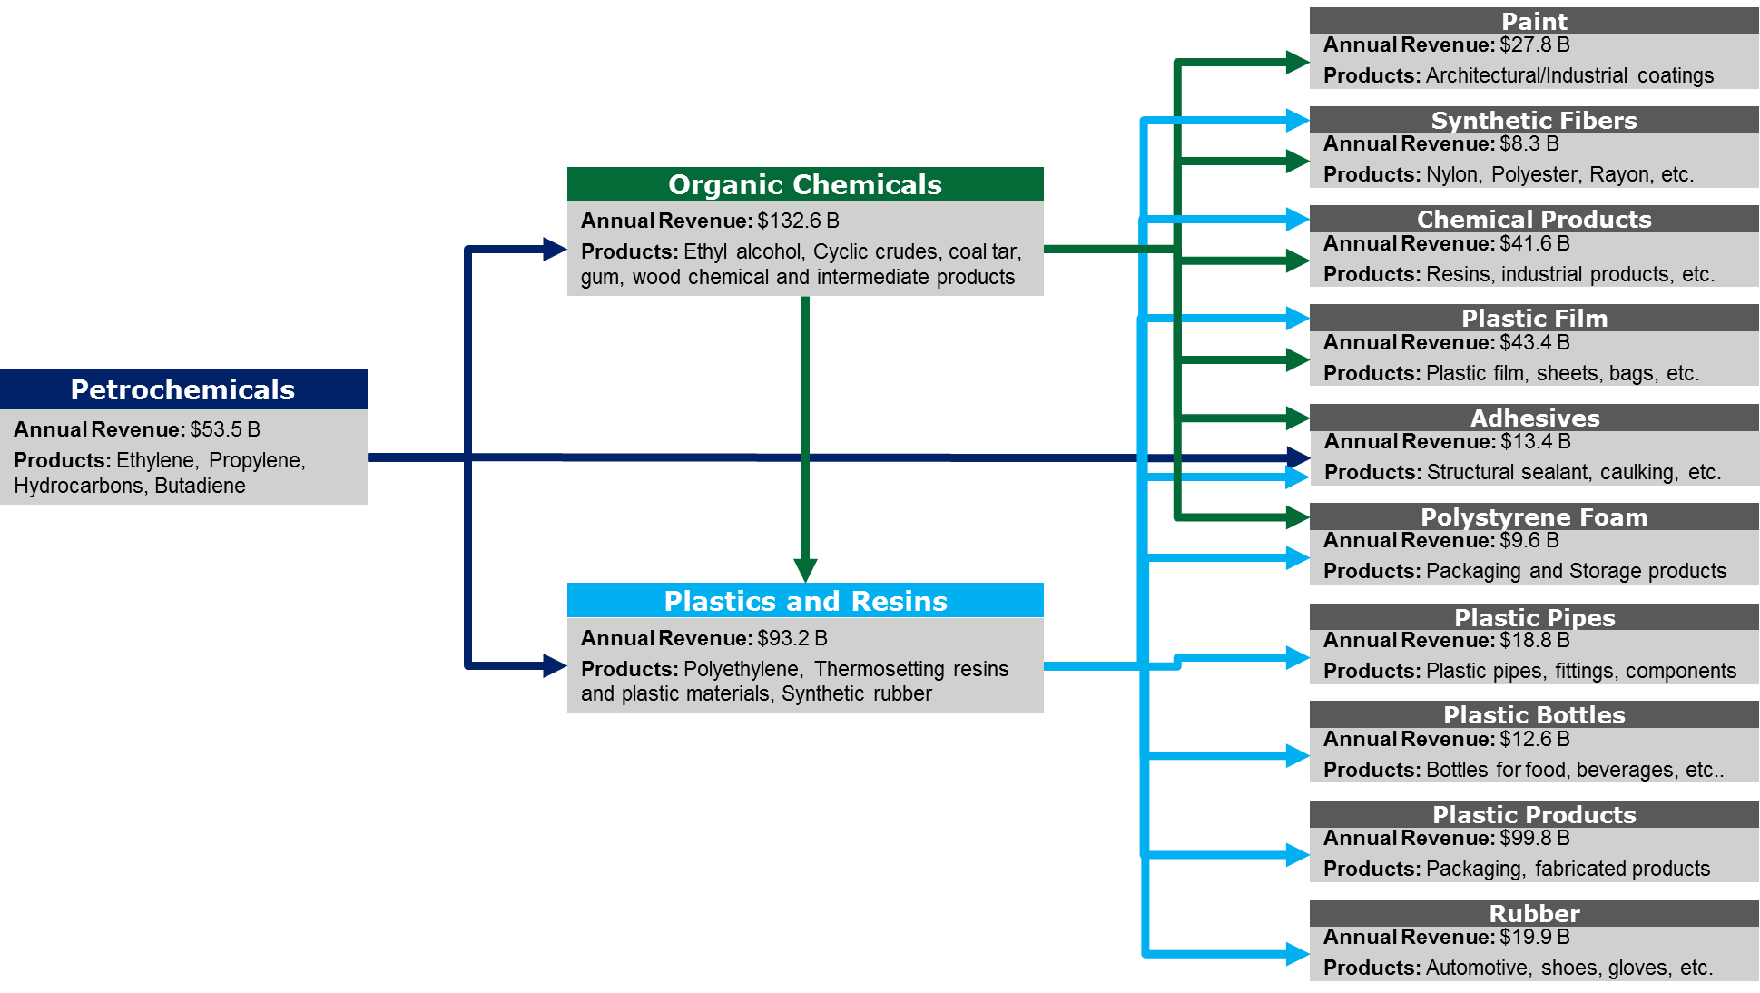
Ethane Related Products a Significant Contributor to GDP

Slide 8
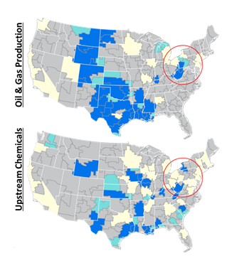
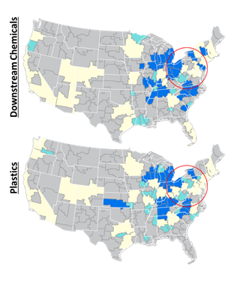

Is Appalachia Realizing the Full Benefit of its Ethane Resource?
Petrochemical Clusters
Petrochemical value chain in Appalachia has significant upstream and downstream activity with little midstream activity
Region is exporting its low cost ethane to Gulf Coast and internationally
Region is importing chemical intermediates derived from ethane elsewhere

Slide 9
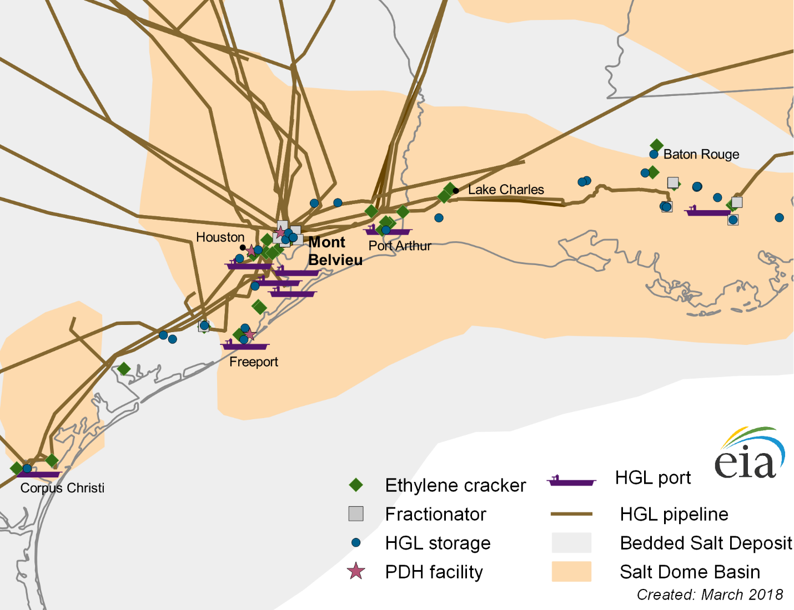
The Majority of Ethylene Capacity is Currently in Gulf Coast
U.S. Ethylene Production Capacity Through 2016 (million metric tons)
Mont Belvieu and Gulf Coast Infrastructure

Slide 10
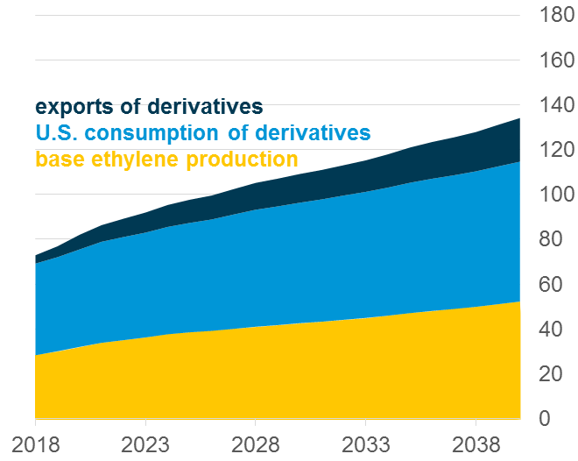
Growth in Ethane Supply Chain Will be Significant
Projected Ethane Supply Chain Capacity in U.S. (million metric tons)
Projected Ethane Supply Chain Utilization in U.S. (million metric tons)
Notes:
Overall, the value of growth in capacity between 2018 and 2040 is expected to be $716 Billion
From 2018 to 2025 production capacity expected to increase 51%
From 2025 to 2040, an additional 23% growth expected from “unspecified” capacity
The value from “unspecified” capacity additions estimated to be $227 Billion

Slide 11
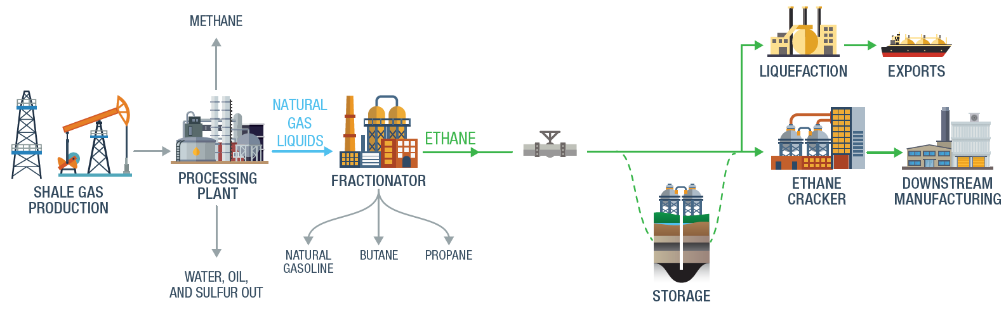
The Ethane Supply Chain
Is Appalachia Positioned to Take Advantage of the Economic Opportunity Expected to Occur in the Ethane Supply Chain?

Slide 12
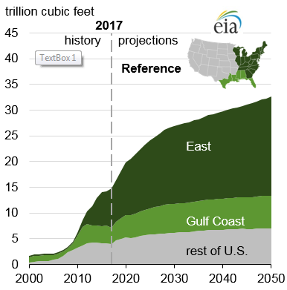
Appalachian Shale Gas Projected to Transform Energy Economy
Shale Gas Production by Region
AEO 2018 projects shale gas production to more than double by 2050
Much of this growth driven by shale gas production in Appalachia
Appalachian production increased almost twenty fold from 2008 to 2017
This trend is expected to continue

Slide 13
Appalachian NG Processing and Fractionator Capacity
Natural Gas Processing/Fractionator Capacity
Appalachian NGLs predominately produced in Ohio River Valley
NGL is recovered from raw natural gas at gas processing plants as a mix
The mixed stream NGL is then split into its constituent components at centralized fractionation plants

Slide 14
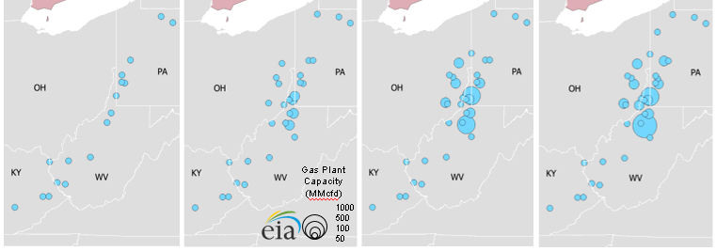
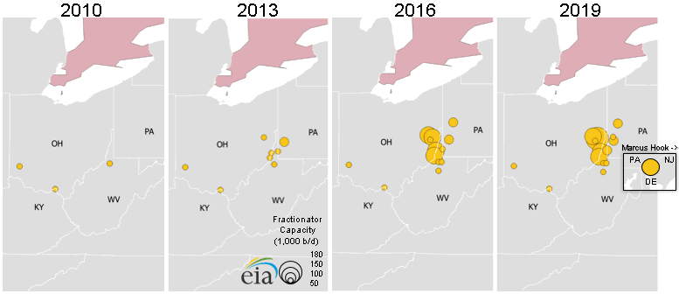
Expansion of Production Capacity in the Ohio Valley Has Been Dramatic
2010 2013 2016 2019
Between 2010 and 2016, natural gas processing capacity in Appalachia increased ten-fold
Fractionation capacity has increased more than twenty-fold over the same time period

Slide 15
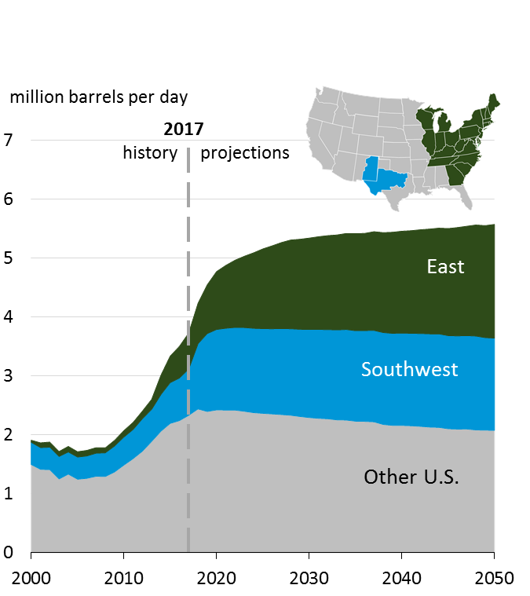
NGL’s from Appalachia are Driving a Surge in Ethane Supply
U.S. NGPLs Production by Region
EIA forecasts NGPLs production to rise by more than 50% between 2017 and 2050
Projected Appalachian ethane production in 2025 is more than 20 times greater than regional production in 2013
Appalachian Ethane Production
Notes:
NGL = refinery LPG + NGPL (Natural Gas Plant Liquid)
Appalachia is actually the east region – Appalachia accounts for 85% of East Region

Slide 16
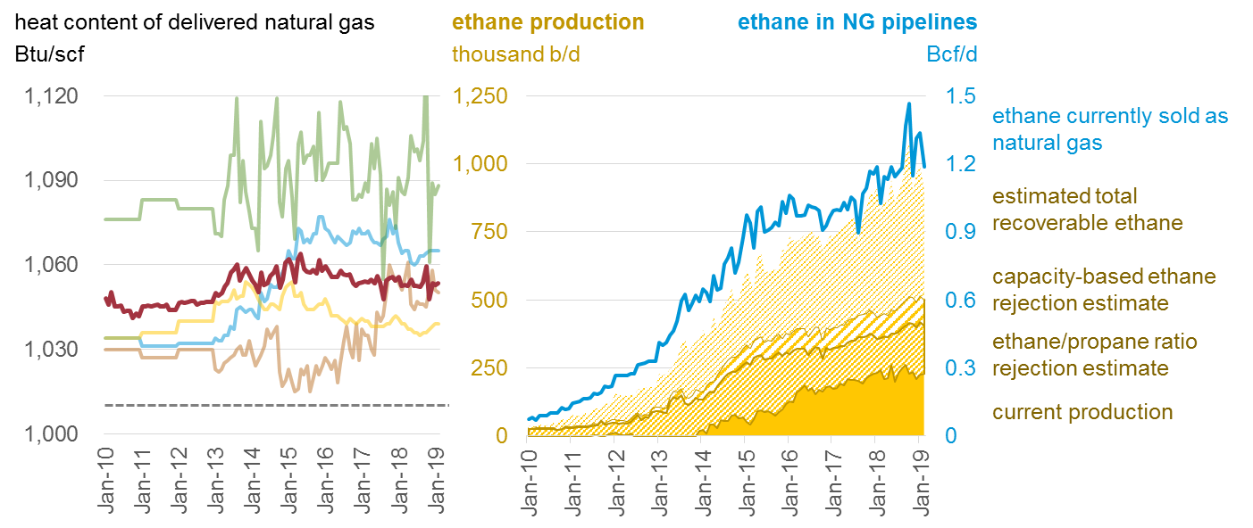
Ethane Rejection Results in Significant Resource Underutilization
Source: EIA Heat Content of Natural Gas Consumed; Natural Gas Gross Withdrawals and Production; Natural Gas Plant Field Production

Slide 17
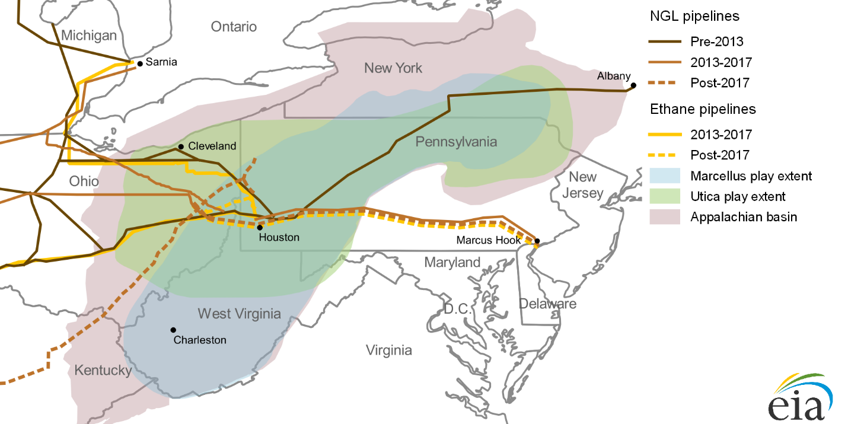
Pipeline Capacity is Positioned to Transport Ethane Out of Appalachia
Appalachia NGL Pipelines
Appalachian Ethane is predominantly
Transported via pipeline to the Gulf Coast for processing
Exported
Combusted
Avoided by producers (rejected)
Value of processing in-region is lost
Notes:
As of now there is no plan to increase connectivity to gulf coast. Utica Marcellus Texas Pipeline is cancelled as of this year.
One Pipeline to Marcus Hook, two pipelines to Canada.

Slide 18
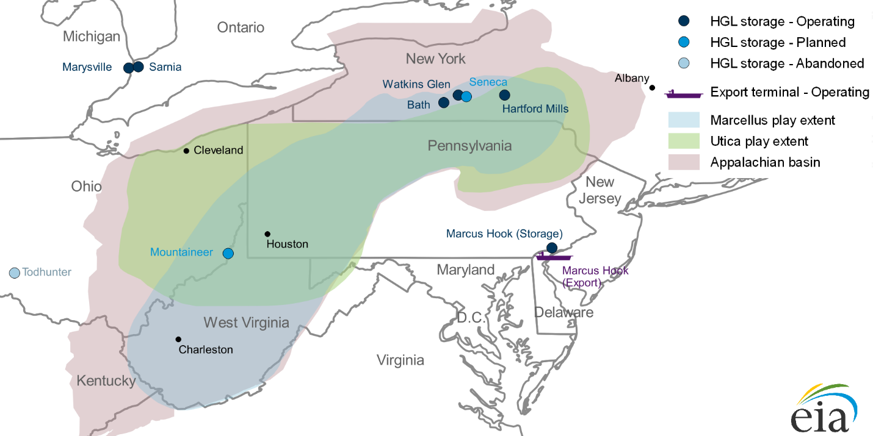
Appalachian Storage Capacity is Non-Existent
NGL Storage and Export Facilities
Storage is essential to managing
Seasonal supply variability
Processing facility outages
Holding for transport or export
Large-scale storage does not exist in the wet gas sub-region of Appalachia
Notes:
Missing the MPLX storage facility in Hopedale

Slide 19
Area Geology Would Enable Sufficient Storage
Appalachian Basin NGL Storage Study
Economics favor underground storage
Candidate geology is in the wet gas region
  Saline caverns
  Hard rock caverns
Underground storage is capital intensive
Report: https://aongrc.nrcce.wvu.edu/
Notes:
This study did not consider project economics, but rather it was a geologic assessment.

Slide 20
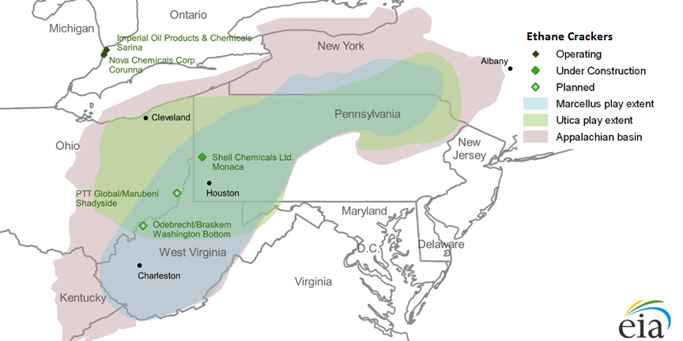
Storage Increasingly Essential to Support Growth
Ethane Crackers
Shell Chemicals Appalachia, LLC (under construction)
$6B-$9B ethane cracker
Two dedicated ethane pipelines
First 3000 of 6000 person construction workforce
500 permanent plant operators
PTT Global Chemicals/Daelim Chemicals (pending)
$10B ethane cracker/derivatives units/other ancillary structures and equipment
Pipeline infrastructure and some storage
6000 person construction workforce
550 permanent plant operators
Notes:
Shell is closer to using 9 billion, not 6 billion any more.

Slide 21
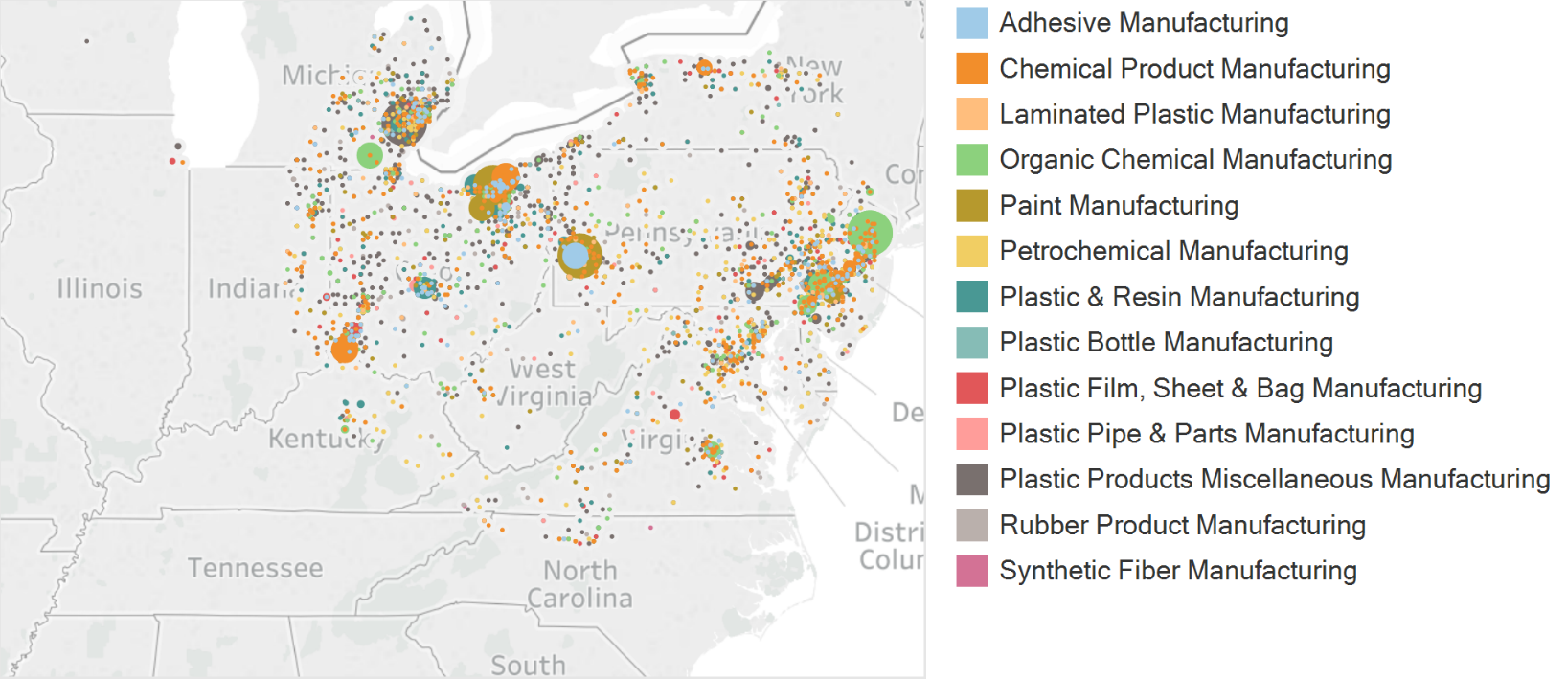
Appalachia and Vicinity Downstream Manufacturing is Significant
Industry Revenue by NAICS Code
13 key petrochemical industries within 300 miles of Pittsburgh
Appalachia accounts for nearly a third of U.S. activity in these 13 petrochemical industries
$300 billion of net revenue
900,000 workers
7,500 establishments

Slide 22
Three Alternative Futures for Appalachia
Scenario A, development of a petrochemical cluster in Appalachia is assumed to increase such that much of the incremental Appalachian supply is processed “locally”
Scenario B, the focus on continued development in the existing cluster of the Gulf Coast is assumed
Scenario C, incremental processing is assumed to occur elsewhere, facilitated by exports of the feedstock

Slide 23
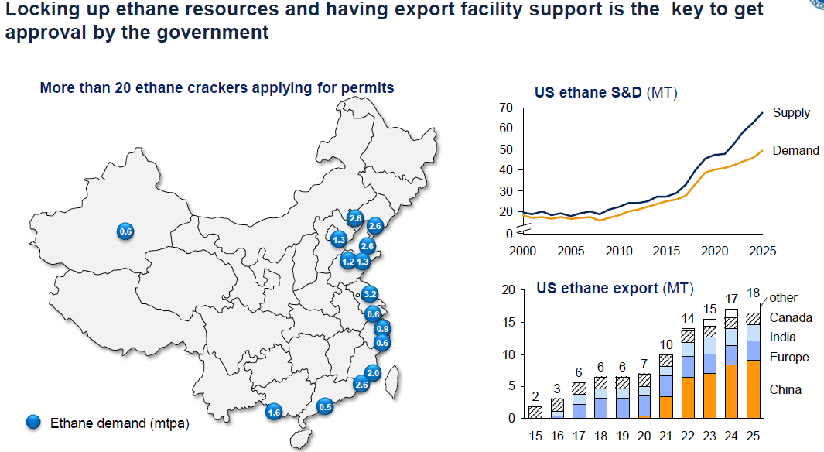
Some Scenario C Related Activities - China
Source: Joe Zhao, Sinochem

Slide 24
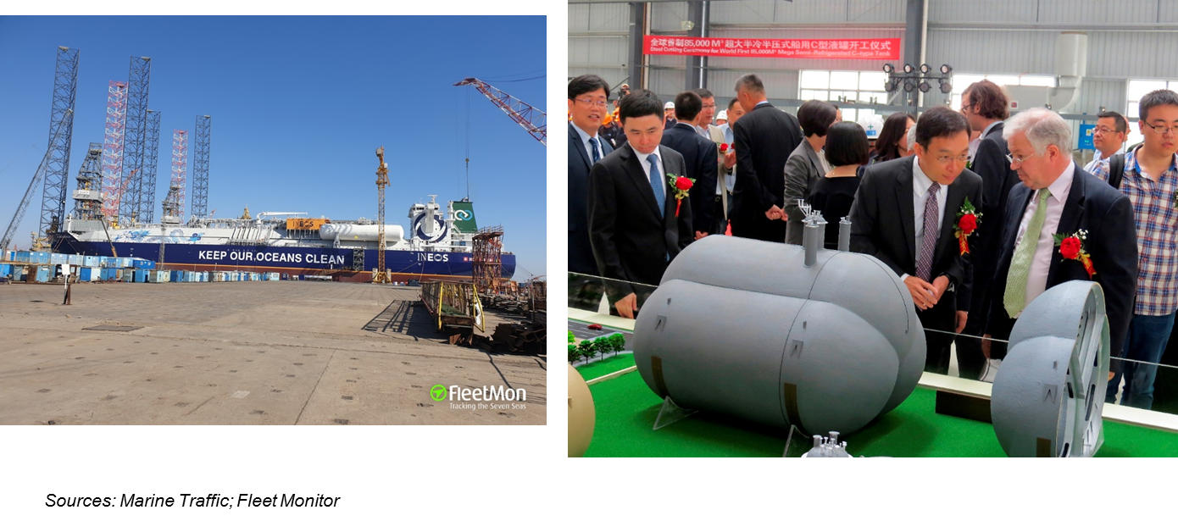
New Class of Very Large Ethane Carrier (VLEC) Hitting Water
JS INEOS Marlin

Slide 25
Why China?
Capex costs 30%-50% below U.S. based projects
Environmental concerns beginning to take center stage, pushing coal-based chemistry out, naphtha down, and light-feed petrochemicals up
Made-in-China 2025
  Accelerate and promote intelligent manufacturing
  Green transformation of the petrochemical industry
  Benefit rural China through agricultural chemicals
  Develop new materials, and focus on upgrading, reducing reliance on imports

Slide 26
Scenario A: Potential Benefits from Appalachian Petrochemical Industry
  2017 American Chemistry Council (ACC) Report
  Four-state region of West Virginia, Pennsylvania, Kentucky and Ohio
  Estimates direct, indirect, and induced impacts of significant infrastructure investment
  5 cracker plants (combined 6.25 million metric tons (mmt) ethylene capacity)
  Derivative plants (combined polyethylene capacity of 4.9 mmt)
  Propane dehydrogenation plants (combined capacity of 1 mmt)
  Polypropylene resin plants (combined capacity: 0.98 mmt)
  Storage hub (capacity: 75 to 100 million barrels for ethane, ethylene, propane and propylene)
  500 miles of pipeline
https://www.americanchemistry.com/Appalachian-Petrochem-Study/

Slide 27
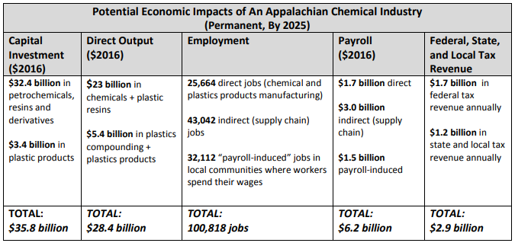
Local Processing Would Result in Significant Economic Benefit
ACC Study Potential Economic Impacts

Slide 28
Decentralizing Petrochemical Industry Important for Energy Security
Present geographic concentration of petrochemical infrastructure along Gulf Coast poses strategic risk
Severe weather events can limit the availability of key feedstocks
Petrochemical expansion in the Appalachian region would increase geographic diversity
Supporting resilience, reliability and security
Geographic diversity provides manufacturers feedstock flexibility and redundancy
Provides purchase and transport alternatives
Would help mitigate the potential for any price spikes that could be caused by disruptive events in any one region of the U.S.

Slide 29
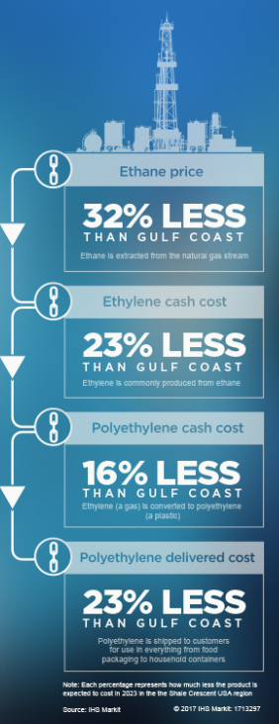
Need for Expanded Private Investment
Industrial investor requirements and the Appalachian business environment
Equitable return on their capital investment
Reliable supply of affordable petrochemical feedstocks
Skilled workforce for construction and operation
Buildable sites
Supporting public infrastructure
Manageable regulatory requirements
Local support

Slide 30
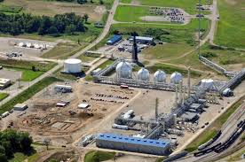
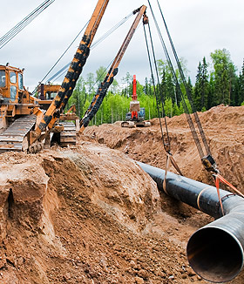
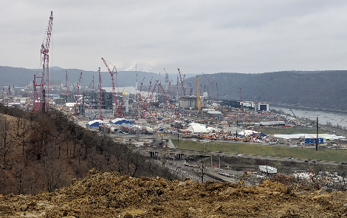
DOE Path Forward
Facilitate the establishment of an Appalachian petrochemicals industry that:
Enhances U.S. energy and manufacturing security
Creates substantial economic benefit
Align the economic resources of federal agencies with stakeholders to catalyze private sector investment
Communicate the market opportunity and its benefits
Invest in supporting public infrastructure
Support energy infrastructure-related workforce development
Facilitate the investment of private capital

Slide 31
Questions?
Contact: Charles.Zelek@hq.doe.gov

