Slide 1
Investing in the Appalachian Storage Hub
Rapid growth requires rethinking how to attract capital. What are investors looking for?
Damian Georgino
Special Counsel
June 7, 2018

Slide 2
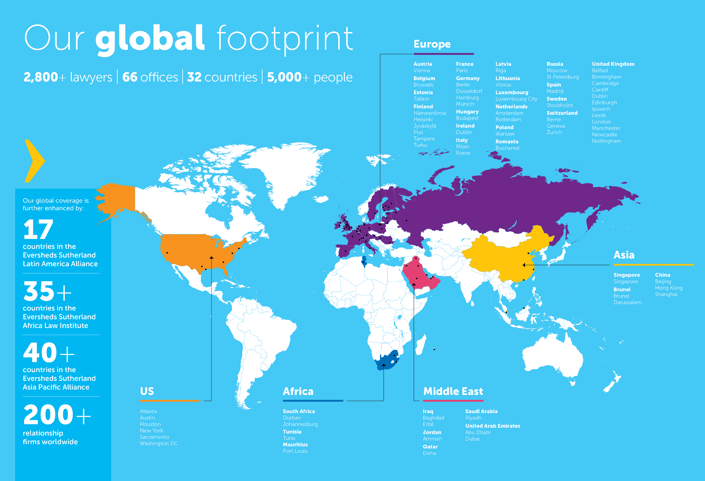

Slide 3
Corporate M&A
Why work with us?
An integrated and seamless service
wherever the transaction is led from,
our international M&A team provides a
seamless and integrated relationship-led
service liaising closely with our clients
and their in-house legal teams. We
ensure that they remain informed and
involved at every stage of the transaction.
Connected locally, committed globally
with international operations in more than
60 offices across Europe, the United States, the Middle East, Asia and Africa, and formal alliance networks in Africa, Latin America and Asia Pacific, we combine substantial global reach with local knowledge and delivery.
Efficiency – our transaction teams are
managed by a single point of contact
across all jurisdictions, ensuring clear
and short lines of communication,
removing duplication and streamlining
the whole M&A process.
Innovation at our heart – we were
ranked number one in the FT Law 50
report, the Financial Times’ ranking of
Europe’s most innovative law firms.
Innovations include DealTrack and
DealMaster, key offerings in the context
of Corporate and M&A.
Eversheds Sutherland helps clients understand the full range of business law, enabling them to grow and thrive. We constantly monitor the economic, regulatory and legislative environment so we can guide clients to new opportunities while minimizing risk. We represent both public and private companies in virtually every type of transaction, and our client list runs the gamut of industries.
Eversheds Sutherland works with clients to raise billions in public and private capital. Our attorneys address practically every corporate legal need, including general corporate advice, finance, mergers, acquisitions and other transformative transactions, corporate governance and compliance in an evolving regulatory environment. We work seamlessly with attorneys in the firm’s other practice areas to meet our clients’ business objectives, allowing clients to benefit from attorneys knowledgeable in each industry's opportunities, hurdles and pitfalls. We oversee complex transactions and matters, and we bring a collaborative, integrated approach to solving problems.
Who do we act for?
international and domestic issuers, including
corporates and investment funds
investment banks and brokers
selling shareholders, including executives and
other insiders

Slide 4
Capital Markets
Why work with us?
We have significant experience with:
initial public offerings
equity offerings, including overnight, bought, marketed and at-the-market deals
debt offerings, including retail notes and convertible debt
transferable and non-transferable rights offerings
private placements of debt and equity capital secondary offerings
block trades
the preparation of ongoing regulatory disclosure filings including shelf registration statements, quarterly, annual and current reports for domestic and foreign issuers
securities holdings reports by insiders and other significant shareholders
annual and special proxy filings and related proxy matters
proxy contests, activist investor engagement, and managing hostile bids
Access to capital may be the single most important factor in the evolution of a business. Knowing when to access the markets and how to structure additional capital issuances in an evolving regulatory environment can present significant challenges. We can advise you on successful capital markets transactions by working alongside you and your other advisers and operating in an efficient and cost effective manner to meet your growth objectives.
We recognise that capital markets transactions are
strategically important for you and present a host of additional difficulties and extra duties, obligations and responsibilities. Using a thorough project management approach, we do everything we can to ensure that transactions run as smoothly as possible, working to minimize the demands on your time and any disruption to your businesses.
Who do we act for?
international and domestic issuers, including
corporates and investment funds
investment banks and brokers
selling shareholders, including executives and
other insiders

Slide 5
Energy & Infrastructure
Why work with us?
Strong industry background. Clients hire us because we understand their business. Whether in the business of oil, gas, power, LNG, renewables, cooperatives, nuclear or related commodities, our clients know we are positioned to provide comprehensive legal advice.
Extensive transactional experience. We work with clients across the energy industry to structure transactions that achieve their business goals. We advise
on a range of transactional matters for energy clients, including M&A, capital markets, project development and finance.
Deep regulatory knowledge. We advise clients on complex energy regulatory, compliance and investigation matters associated with government oversight. That kind of knowledge is also critical to any successful transaction.
Our US Energy and Infrastructure Group has more than 70 lawyers representing every major sector of the energy industry. Our 40-year history of excellence in serving the regulatory, compliance and policy
needs of our clients complements the commercial, financial and operational
experience we bring to increasingly complex transactions. Combined with our team
of well-regarded, high-profile litigators, Eversheds Sutherland’s energy practice is well-positioned to provide the full range of legal services to our energy clients.
Our services
Energy M&A
Energy finance and project development
Energy capital markets
Environmental
Energy restructuring and creditors’ rights
Energy litigation
Energy policy and governmental affairs
Energy and commodities trading
Commodities enforcement and investigations
Regulatory and compliance

Slide 6
Damian Georgino
Special Counsel
Office: (212) 287-7021
Mobile: (858) 245-3408 damiangeorgino@eversheds-sutherland.com
Eversheds Sutherland (US) LLP
The Grace Building, 40th Floor
1114 Avenue of the Americas
New York, NY 10036

